Slide 1



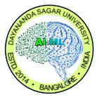
Dayananda Sagar University (DSU) - Main Campus
School of Engineering
Devarakaggalahalli, Harohalli Kanakapura Road, Bengaluru South Dist., Karnataka 562112
DEPARTMENT OF
COMPUTER SCIENCE AND ENGINEERING
(ARTIFICIAL INTELLIGENCE AND MACHINE LEARNING)
Generative -AI (23AM3609)
Synopsis
Title: “RAG-Based Intelligent Document Chatbot using Generative AI”
Lochana Charvi G ENG23AM0039
Jayasundari K ENG23AM0241
H D ThimmaReddy ENG23AM0028
Harikrishna H P ENG23AM0029
Academic Year: 2025-2026(Even Semester)

Slide 2

Contents
Aim
Objectives
Methodology
References

Slide 3
AIM
To build an intelligent document chatbot using RAG and Generative AI.
To allow users to upload documents and ask questions in natural language.
To extract meaningful information from different document formats.
To retrieve relevant content using semantic search techniques.
To generate accurate and context-aware answers using large language models.
To improve accessibility to document-based knowledge.
To reduce manual effort in searching through large documents.
To provide a scalable and user-friendly AI-powered system

Slide 4
Objectives
To develop a RAG-based intelligent chatbot that efficiently retrieves relevant information from uploaded documents using semantic search techniques.
To generate accurate and context-aware answers by integrating retrieved document content with Generative AI and Large Language Models.
To design a simple and user-friendly interface that allows users to upload documents and interact with the chatbot easily for quick information access.

Slide 5
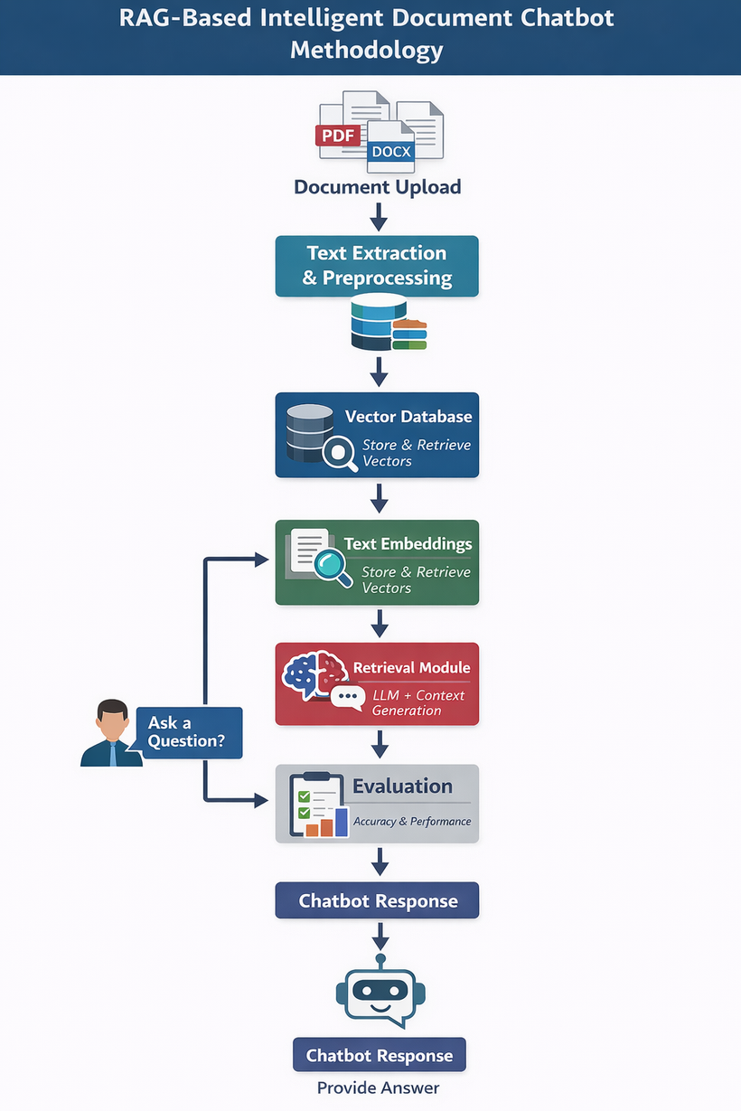
Methodology
Upload documents (PDF, DOCX, TXT) into the system.
Extract and preprocess text from the uploaded documents.
Convert text chunks into embeddings using an embedding model.
Store embeddings in a vector database for semantic search.
Accept user queries in natural language.
Retrieve the most relevant document chunks from the vector database.
Generate answers using the RAG framework by combining retrieved content with a Large Language Model.
Display chatbot responses and evaluate performance for accuracy and relevance.

Slide 6
References
[1] P. Lewis et al., “Retrieval-Augmented Generation for Knowledge-Intensive NLP Tasks,” Advances in Neural Information Processing Systems (NeurIPS), 2020.
[2] A. Vaswani et al., “Attention Is All You Need,” in Proc. Advances in Neural Information Processing Systems (NeurIPS), 2017.
[3] V. Karpukhin et al., “Dense Passage Retrieval for Open-Domain Question Answering,” in Proc. EMNLP, 2020.
[4] T. Brown et al., “Language Models are Few-Shot Learners,” OpenAI Technical Report, 2020.
[5] OpenAI, “GPT-4 Technical Report,” 2024.
[6] H. Chase, “LangChain: Building Applications with Large Language Models,” 2024.
[7] J. Johnson et al., “FAISS: A Library for Efficient Similarity Search and Clustering of Dense Vectors,” IEEE Transactions on Big Data, 2019.
[8][T. Wolf et al., “Transformers: State-of-the-Art Natural Language Processing,” Hugging Face, 2020.
[9] A. Radford et al., “Improving Language Understanding by Generative Pre-training,” OpenAI, 2018.
[10] X. Zhang et al., “Semantic Search with Vector Embeddings for Document Retrieval,” IEEE Access, 2021.

Slide 7


